Slide 1
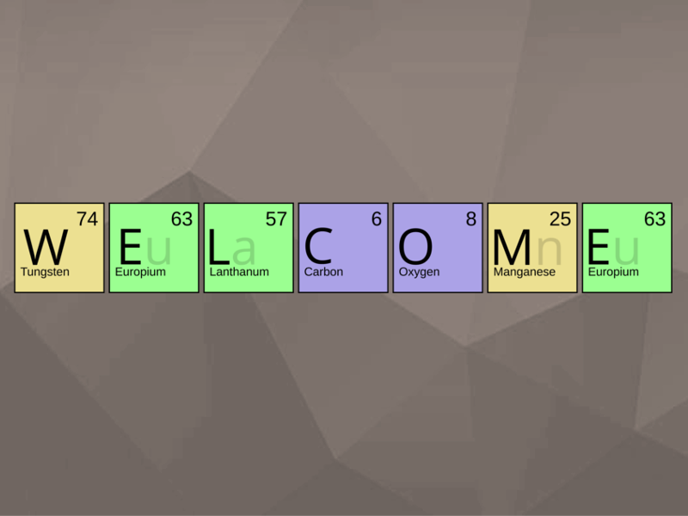

Slide 2
Unimolecular reactions and chain reactions
Presented by
Amrutha Raj

Slide 3

The generalised explanation is as follows.
The reactant molecule A gets activated by collisions with another
molecule.
A + A → A* + A d[A*]/dt = ka[A]2
Collisions with other molecule can result in loss of this energy.
A + A* → A + A
d[A*]/dt = -k’a[A][A*]
Some activated molecules may form products.
A* → P
d[A*]/dt = -kb[A*]
In case the unimolecular decay is slow, the net reaction is first order.
This can be demonstrated by applying steady state for the formation of
A*.
d[A*]/dt = ka[A]2 - k’a[A][A*] - kb[A*] ≈ 0
Solution is,
[A*] = ka[A]2/{kb + k’a[A]}

Slide 4
How do they occur?
Look at the following reaction.
Cyclo-C3 H6 → CH3 - CH=CH2, the rate = k[cyclo-C3H6]
These are unimolecular reactions.
The reactant molecules somehow have enough energy to react by
themselves. How can energy transfer occur without collisions?
The first successful explanation of unimolecular reactions is by
Frederick Lindemann in 1921 and elaborated later by
Cyril Hinshelwood. This mechanism is called as
Lindemann- Hinshelwood mechanism.

Slide 5
The rate law for the formation of P is,
d[P]/dt = kb[A*] = kakb[A]2/{kb + k’a[A]}
As can be seen, the rate law is not first order.
The important aspect is that rate of deactivation of A* by collisions
with A is much larger than the rate of unimolecular decay.
k’a[A*][A] » kb [A*] or k’a[A] » kb
Thus we can neglect kb in the denominator and write,
d[P]/dt ≈ k[A] where
k = kakb/k’a
This is a first order rate law.
The rate expression also shows that when the concentration
(partial pressure) of A is small, then ka’[A] << kb, we get
d[P]/dt ≈ ka[A]2

Slide 6
If we write the rate expression as,
d[P]/dt = k[A]
where
k = kakb[A]/{kb + k’a[A]}
The effective rate constant is,
1/k = k’a/(kakb) + 1/ka[A]
The test for the theory is to get a straight line for 1/k vs. 1/[A] plot.
A typical plot is seen below.

Slide 7
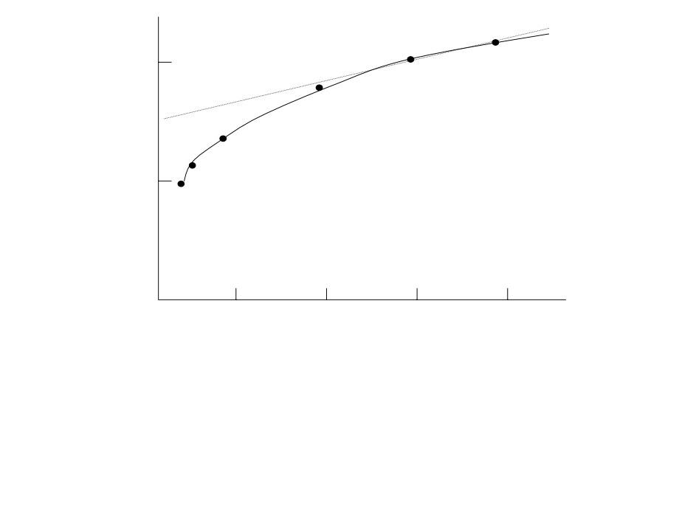
2
1/k
1
0
0
0.5
1.0
1.5
2.0
1/[A]
The behaviour is in gross agreement with the theory. At high pressures
(lower 1/[A]) the value of k higher (lower 1/k) than expected from a liner
behaviour. The reaction studied is the unimolecular isomerization of trans-
CHD=CHD. The Lindemann-Hinshelwood mechanism is the straight line,
extrapolation from lower pressure (larger 1/[A]) to higher pressure (smaller
1/[A]).

Slide 8
Chain reactions

Slide 9
Chain reactions are examples of complex reactions, with complex rate
expressions.
In a chain reaction, the intermediate produced in one step generates an
intermediate in another step.
This process goes on.
Intermediates are called chain carriers. Sometimes, the chain carriers
are radicals, they can be ions as well. In nuclear fission they are
neutrons.

Slide 10
There are several steps in a chain reaction.
1. Chain initiation
This can be by thermolysis (heating) or photolysis (absorption of light)
leading to the breakage of a bond.
CH3CH3 Æ 2.CH3
2. Propagation
In this, the chain carrier makes another carrier.
⋅CH3 + CH3CH3 → CH4 + ⋅CH2CH3

Slide 11
3. Branching
One carrier makes more than one carrier.
⋅O⋅ + H2O → HO⋅ + HO⋅
(oxygen has two unpaired electrons)
4. Retardation
Chain carrier may react with a product reducing the rate of formation
of the product.
⋅H + HBr → H2 + ⋅Br
Retardation makes another chain carrier, but the product concentration
is reduced.

Slide 12
5. Chain termination
Radicals combine and the chain carriers are lost.
CH3CH2. + CH3CH2⋅ → CH3CH2CH2CH3
6. Inhibition
Chain carriers are removed by other processes, other than termination,
say by foreign radicals.
CH3CH2⋅ + ⋅R → CH3CH2R
All need not be there for a given reaction.
Minimum necessary are,
Initiation, propagation and termination.

Slide 13
How do we account for the rate of laws of chain reactions?
Look at the thermal decomposition of acetaldehyde. This appears to
follow three-halves order in acetaldehyde.
Overall reaction,
CH3CHO(g) → CH4(g) + CO(g) d[CH4]/dt = k[CH3CHO]3/2
The mechanism for this reaction known as Rice-Herzfeld mechanism
is as follows.
Product
(a) Initiation:
CH3CHO → ⋅CH3 + ⋅CHO
R = ka [CH3CHO]
(b) Propagation:
CH3CHO + ⋅CH3 → CH4 + CH3CO⋅
R = kb [CH3CHO] [⋅CH3]
R = kc [CH3CO⋅]
(c) Propagation:
CH3CO⋅ → ⋅CH3 + CO
⋅CH3 + ⋅CH3 → CH3CH3
(d) Termination:
R = kd [⋅CH3]2

Slide 14
Although the mechanism explains the principal products, there are
several minor products such as acetone (CH3COCH3) and propanal
(CH3CH2CHO).
The rate equation can be derived on the basis of steady-state
approximation. The rate of change of intermediates may be set equal to
zero.
d[⋅CH3]/dt = ka[CH3CHO] - kb[⋅CH3][CH3CHO] + kc[CH3CO⋅]
-2kd[⋅CH3]2 = 0
d[CH3CO⋅]/dt = kb[⋅CH3][CH3CHO] - kc[CH3CO⋅] = 0

Slide 15
The sum of the two equation is,
ka[CH3CHO] - 2kd[⋅CH3]2 = 0
The steady-state concentration of ⋅CH3 radicals is,
[⋅CH3] = (ka/2kd)1/2 [CH3CHO]1/2
It follows that the rate of formation of CH4 is
d[CH4]/dt = kb[⋅CH3][CH3CHO] = kb (ka/2kd)1/2 [CH3CHO]3/2
Thus the mechanism explains the observed rate expression. It is sure that
the true rate law is more complicated than that observed experimentally.
There are several cases where the reaction is complicated.

Slide 16
Explosions
There are two kinds: thermal and chain-branching.
Thermal: This is because in an exothermic reaction if the energy
cannot escape, the reaction rate increases fast due to concentration
of energy.
Chain-branching: In this case, there are chain branching reactions
and the number of carriers grows exponentially.
An example of the latter type,
2H2(g) + O2(g) → 2H2O(g)
The mechanism is very complex. Yet there are these steps, which
explain explosion.

Slide 17
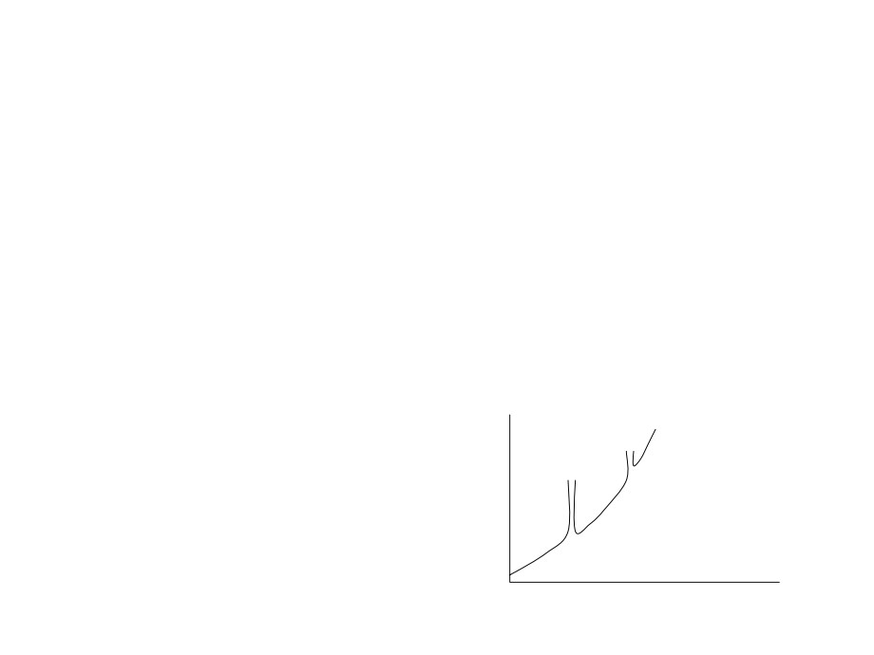
Initiation: H2 + O2 → ⋅OH + ⋅OH
Propagation: H2 + ⋅OH → ⋅H + H2O
O2 + ⋅H → ⋅O⋅ + ⋅OH
(branching)
⋅O⋅ + H2 → ⋅OH + ⋅H
(branching)
⋅H + O2 + M → HO2⋅ + M*
The explosions depend on temperature and pressure.
This is explained in the figure below
R
T

Slide 18
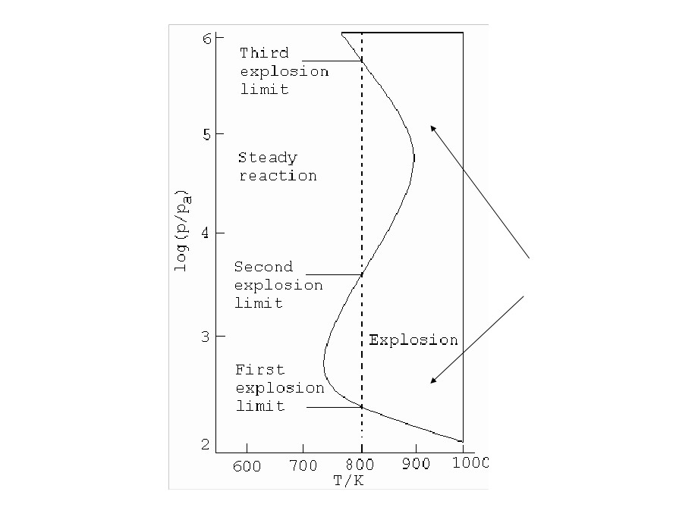
Regions of explosion

Slide 19
At low pressures the chain carriers can reach the walls and get lost.
No explosion happens. As the pressure is increased along the
dotted line shown, the radicals react before reaching the walls and
the reaction suddenly becomes explosive. This is the first explosion
limit. In the second explosion limit, the pressure of the products is
high so that reactions of the type, O2 + H.→ .O2H occur. These
recombination reactions become efficient as the excess energy
can be removed by three body collisions. Then the reaction goes
smoothly. In the third explosion limit, thermal explosion occur.
In this limit, reaction such as HO2. + H2 → H2O2 + H.
dominates the elimination of HO2. by the walls.

Slide 20
THANK YOU

