Slide 1
SKEWNESS AND KURTOSIS
SACHAINA K Assistant Professor
PG Department of Commerce

Slide 2
MEASURES OF SKEWNESS
(Measures of Symmetry)
SYMMETRIC DISTRIBUTION
A frequency distribution is said to be symmetric if the frequencies are distributed evenly on either side of the average
So for a symmetric distribution Q3 and Q1 are equidistant from median

Slide 3
Skewness
Skewness means lack of symmetry .
If a frequency distribution is skewed, there will be more items on one side of the mode than the other side.
Mean median and mode of a skewed distribution are not equal.
Q1 and Q3 will not be equidistance from median.it has long tail on one side and short on other side

Slide 4
Positive and Negative skewness
Positive
Skewness is said to be positive if Mean is greater than Median greater than Mode
Curve is skewed to the right
More than half of the area falls on the right side
Negative
Skewness is said to be negative if Mean is less than Median less than Mode.
Curve is skewed to the left
More than half of the area falls on the left side

Slide 5
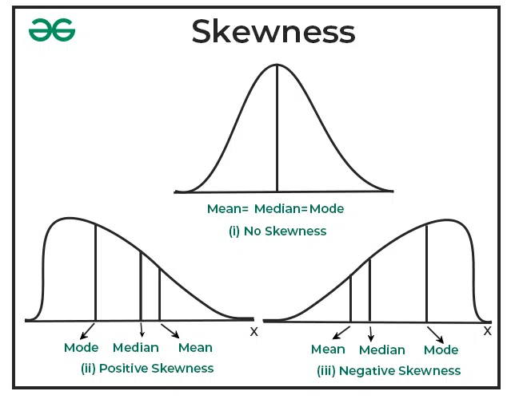

Slide 6
Measure of skewness
J = mean- mode / Standard deviation
J= 3(mean – median / SD
J= (Q3+Q1-2 median) / SD

Slide 7
Measures of Kurtosis
Kurtosis indicates whether a distribution is flat topped or peaked
Measure of peakedness
If a frequency curve is more peaked than normal its called leptokurtic
When the curve is more flat than normal its called platy kurtic
If the curve is neither peaked or flat its called meso kurtic

Slide 8
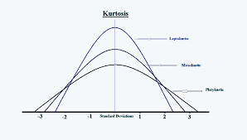

Slide 9
THANK YOU

